Slide 1
APPLIED PHYSICS
(SEAP-113)

Slide 2
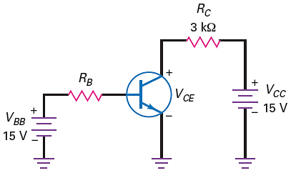

Q Point of BJT
Q point is also called Quiescent Point of transistor or DC operating point of transistor
We have base bias circuit, means a fix base
current is flowing
If R_{B} has values of 1Mohm then base current
will be 14.3𝜇A and if 𝛽_{dc} has value of 100
then collector current will be equal to
1.43mA and
$$\begin{matrix}V_{CE}=V_{CC}−I_{c}R_{c} \\ V_{CE}=15−\left(1.43×{10}^{−3}\right)\left(3×{10}^{3}\right) \\ V_{CE}=10.7V\end{matrix}$$
Therefore the Q point of the transistor will be (10.7V, 1.43mA)

Slide 3
Graphical Solution
Q point can also be find out by graphically
We know that
$\begin{matrix}V_{CE}=V_{CC}−I_{c}R_{c} \\ \end{matrix}$
$$I_{c}=\frac{V_{CC}−V_{CE}}{R_{c}}$$
If we plot this equation (I_{c} versus V_{CE}) we will get a straight line and that line is called Load Line (if represent the effect of load on transistor)
The end of this line can be easily found, first put V_{CE} equal to zero and then I_{C} equal to zero

Slide 4
Graphical Solution (contd.)
When V_{CE} equal to zero, we get
$$I_{c}=\frac{15V−0}{3kΩ}=5mA$$
So first end point will be (0V, 5mA)
When I_{C} equal to zero, we get
$$0=\frac{15V−V_{CE}}{3kΩ}⇒V_{CE}=15V$$
And second end point will be (15V, 0Amp)
By plotting the above points we will get a straight line called Load Line

Slide 5
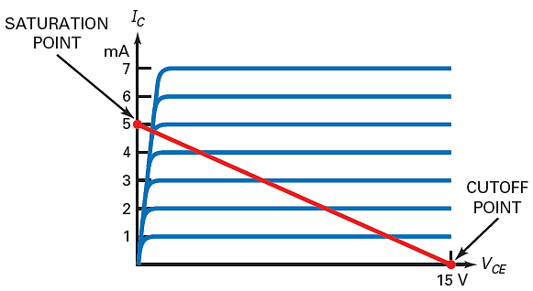
Graphical Solution (contd.)

Slide 6
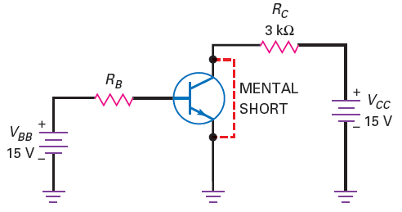
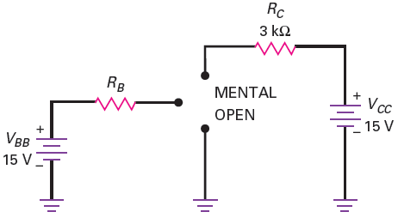
Graphical Solution (contd.)

Slide 7
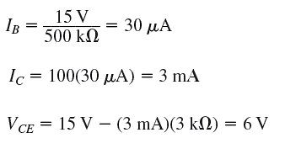
Load Line and Q point Plotting
Draw the load line and plot the Q point for the following circuit.
First of all we will find the end points of the
load line, which are $I_{C(sat)}=5mA and V_{CE(cutt off)}=15V$

Slide 8
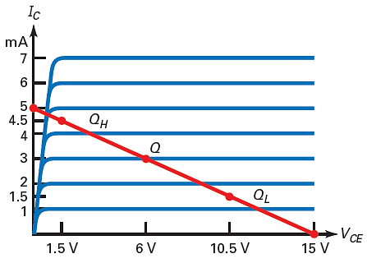
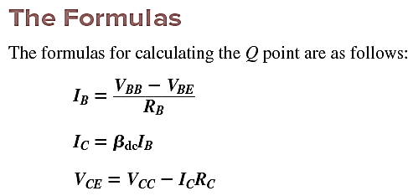
Load Line and Q point Plotting (Contd.)
Now if we change the value of beta
If $β_{dc}=50$then I_{c} = 1.5mAmp and V_{CE} = 10.5V
If $β_{dc}=150$then I_{c} = 4.5mAmp and V_{CE} = 1.5V

